Slide 1
Credit card Fraud detection using CNN
Done By: M.Vinitha
Reg No:912321104052
. Nanmudhalvan Id:au912321104052
Branch: III rd year CSE
College Name:SACS MAVMM Engineering College

Slide 2

OUTLINE
Problem Statement
Proposed System / Solution
System Development Approach
Algorithm & Deployment
Result
Conclusion
Reference

Slide 3
PROBLEM STATEMENT
The Credit Card Fraud Detection Problem includes modeling past credit card transactions with the knowledge of the ones that turned out to be a fraud. This model is then used to identify whether a new transaction is fraudulent or not. Our aim here is to detect 100% of the fraudulent transactions while minimizing the incorrect fraud classification.

Slide 4
PROPOSED SYSTEM / SOLUTION
1.Data Preprocessing:
Gather a dataset of credit card transactions, with labels indicating fraudulent and non-fraudulent transactions.Normalize the data to ensure consistency and improve model performance.Split the data into training and testing sets.
2.Model Architecture: Design a CNN architecture suitable for processing 2D data (since credit card transaction data can be represented as 2D matrices).The input layer would consist of the transaction data, possibly reshaped to fit the CNN input requirements

Slide 5
PROPOSED SYSTEM / SOLUTION(CONTD…)
3. Training: Train the CNN model on the training data.Use techniques like dropout to prevent overfitting.Optimize the model using techniques like gradient descent or Adam optimization.
4. Evaluation: Evaluate the model performance on the testing dataset using metrics like accuracy, precision, recall, and F1-score.Adjust the model hyperparameters if necessary to improve performance.

Slide 6
PROPOSED SYSTEM / SOLUTION(CONTD…)
5. Deployment: Deploy the trained model in a production environment where it can continuously monitor credit card transactions in real-time.Integrate the model with existing fraud detection systems or develop a new system specifically for this purpose.
6. Monitoring and Maintenance: Regularly monitor the model’s performance and retrain it with new data if necessary to ensure its effectiveness over time.Update the model architecture or hyperparameters as needed to adapt to changing fraud patterns

Slide 7
SYSTEM DEVELOPMENT APPROACH
a.Hardware requirements
CPU/GPU:
A powerful CPU or GPU to handle the computational load, especially during training.
Memory (RAM):
Sufficient RAM is required to load the dataset into memory during training and testing.The amount of RAM needed depends on the size of the dataset and the complexity of the model architecture.
Storage:
Adequate storage space is necessary to store the dataset, trained model weights, and any intermediate results.

Slide 8
SYSTEM DEVELOPMENT APPROACH(CONTD…)
b.Software requirements:
Python:
Python is the primary programming language used for implementing deep learning models and data preprocessing.
CUDA (Compute Unified Device Architecture):
CUDA enables efficient parallel computing on NVIDIA GPUs and is required for deep learning frameworks like TensorFlow and PyTorch to utilize GPU resources.

Slide 9
SYSTEM DEVELOPMENT APPROACH(CONTD…)
CuDNN (CUDA Deep Neural Network library):
CuDNN is a GPU-accelerated library for deep neural networks, providingoptimized implementations of CNN operations.It enhances the performance of deep learning frameworks when running on NVIDIA GPUs.
Development Environment:
Choose an integrated development environment (IDE) or text editor for writing and executing Python code.Popular choices include PyCharm, Visual Studio Code, and Jupyter Notebooks.
Version Control:
Utilize version control systems like Git for managing code changes and collaboration with team members.

Slide 10
ALGORITHM & DEPLOYMENT
Algorithm:
Step 1: Dataset is imported Step 2: The imported dataset is read Step 3: For balancing the dataset Random Sampling is done Step 4: The dataset is divided into two parts, i.e., the Train dataset and Test dataset. Step 5: Feature selection is applied for the proposed models. Step 6: Accuracy and performance metrics are calculated to know the efficiency of the algorithm. Step7: We build a Convolutional Neural Network Step8: We predict from the test dataset. Step 9: Perform logistic regression to find accuracy precision and recall value Step 10: Then will predict the loss and accuracy and create a confusion matrix for our model

Slide 11
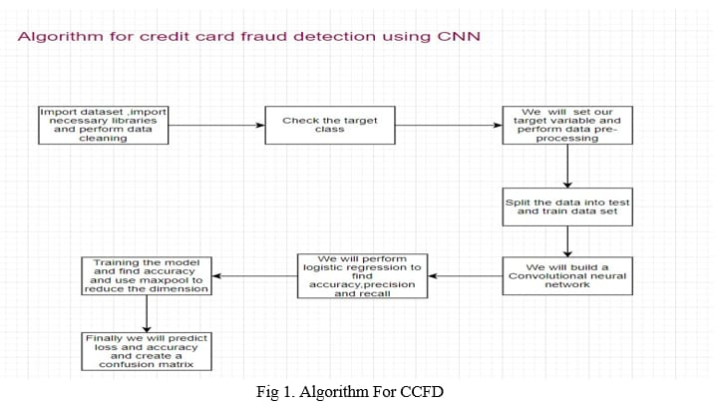
ALGORITHM & DEPLOYMENT(CONTD…)

Slide 12
ALGORITHM & DEPLOYMENT(CONTD…)
Deployment:
Choose Deployment Platform:
Determine the platform(s) where the model will be deployed, such as:
Web application
Mobile application (iOS, Android)
Model Serialization:
Serialize the trained CNN model into a format suitable for deployment. Common serialization formats include:
TensorFlow Saved Model format (.pb)
PyTorch model checkpoint (.pt)

Slide 13
ALGORITHM & DEPLOYMENT(CONTD…)
Performance Optimization:
Optimize the deployed model and preprocessing pipeline for performance:
Reduce model size and computational complexity for faster inference.
Implement techniques like quantization or model pruning to reduce memory and processing requirements.
User Interface (UI):
Design a user-friendly interface for interacting with the deployed system:
Provide intuitive input methods for users to upload or capture.
Display model predictions along with confidence scores or probabilities.

Slide 14
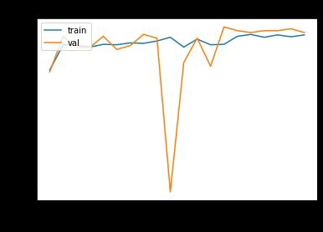
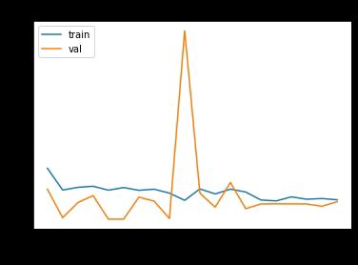
RESULT
Fig:Model Accuracy
Fig: Model Loss

Slide 15
CONCLUSION
A Convolutional Neural Networks (CNNs) for credit card fraud detection presents a promising approach due to their ability to effectively extract features from transaction data. Through the utilization of CNNs, financial institutions can enhance their fraud detection systems by accurately identifying fraudulent activities while minimizing false positives.

Slide 16
REFERENCE
https://www.tensorflow.org/
https://keras.io/
https://numpy.org/
https://matplotlib.org/
https://www.sky-learn.com/
https://www.kaggle.com/code/meet3010/credit-card-fraud-detection-using-cnn

Slide 17


